Slide 1
Ongoing development
may 12, 2024
Renato poli

Slide 2
Status
Working on the elastic homogenization application we are
Validation went through
Mesh generator
Running simple testcases

Slide 3
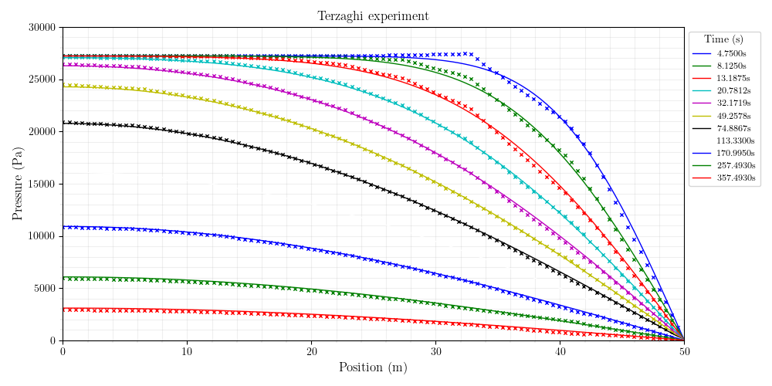
Mesh Information:
elem_dimensions()={3}
spatial_dimension()=3
n_nodes()=1798
n_local_nodes()=515
n_elem()=942
n_local_elem()=235
n_active_elem()=942
TERZAGHI, CRANK NICHOLSON (9s)

Slide 4
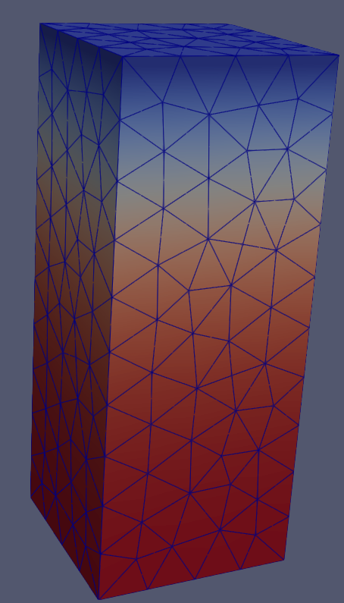
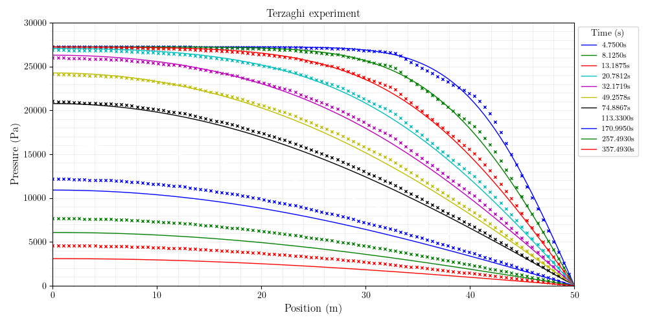
Mesh Information:
elem_dimensions()={3}
spatial_dimension()=3
n_nodes()=1798
n_local_nodes()=515
n_elem()=942
n_local_elem()=235
n_active_elem()=942
TERZAGHI, IMPLICIT

Slide 5
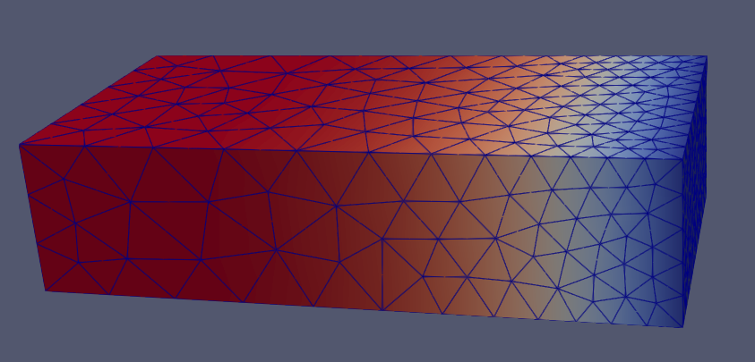
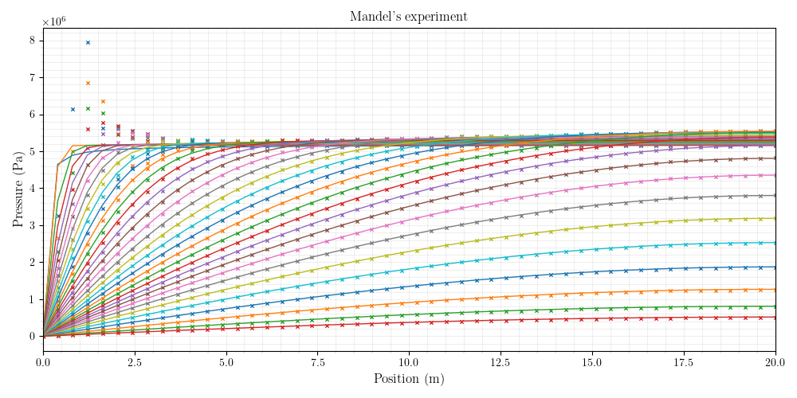
MANDEL – CRANK NICHOLSON
Mesh Information:
elem_dimensions()={3}
spatial_dimension()=3
n_nodes()=3188
n_local_nodes()=858
n_elem()=1756
n_local_elem()=439
n_active_elem()=1756

Slide 6
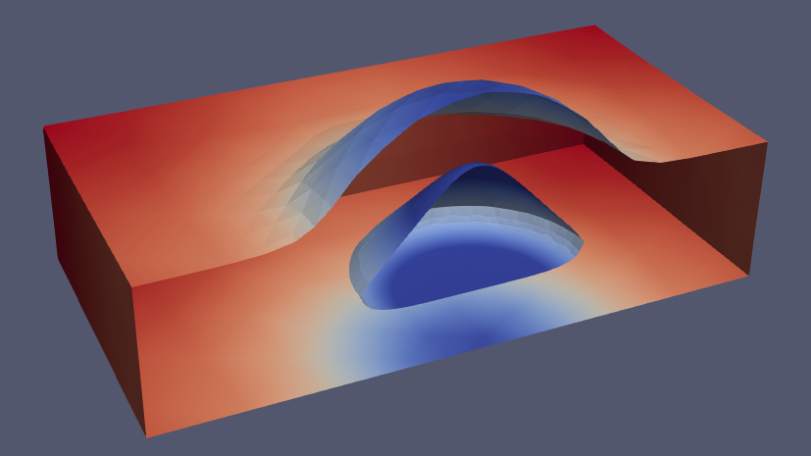
Mesh Information:
elem_dimensions()={3}
spatial_dimension()=3
n_nodes()=18045
n_local_nodes()=4867
n_elem()=12115
n_local_elem()=3028
n_active_elem()=12115
MASS BALANCE
197s

Slide 7
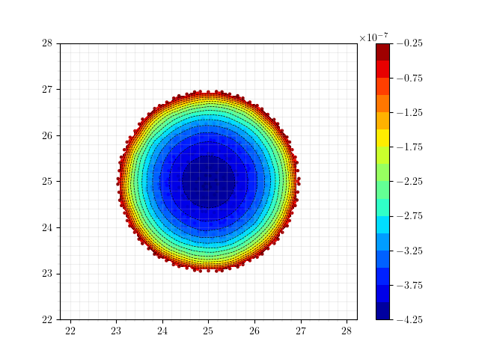
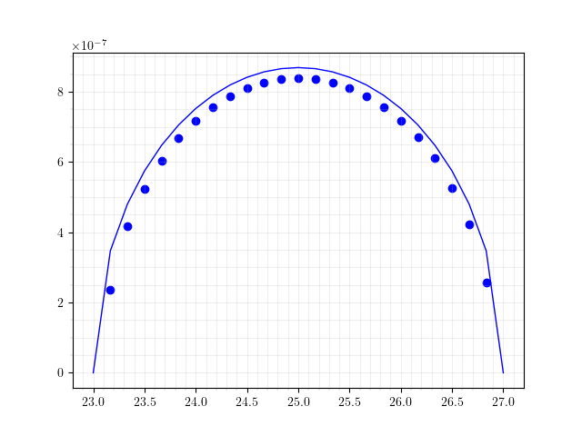
SNEDDON, COARSE MESH
Mesh Information:
elem_dimensions()={3}
spatial_dimension()=3
n_nodes()=13086
n_local_nodes()=3829
n_elem()=9138
n_local_elem()=2285
n_active_elem()=9138
Time: 10s
Maximum UZ displacement: 4.1952e-07
WMAX: 4.3450e-07
ERR: -3.45 %
Notes:
Book (VALKO, ECONOMIDES)

Slide 8
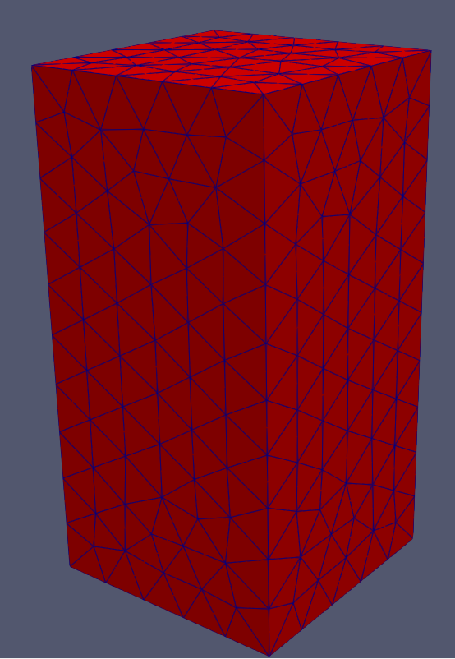
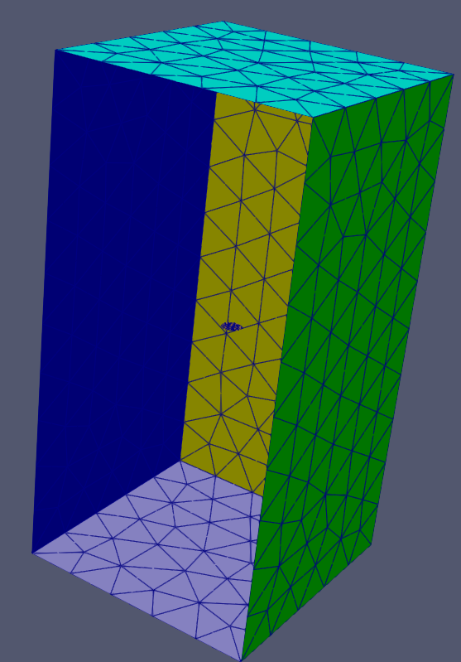
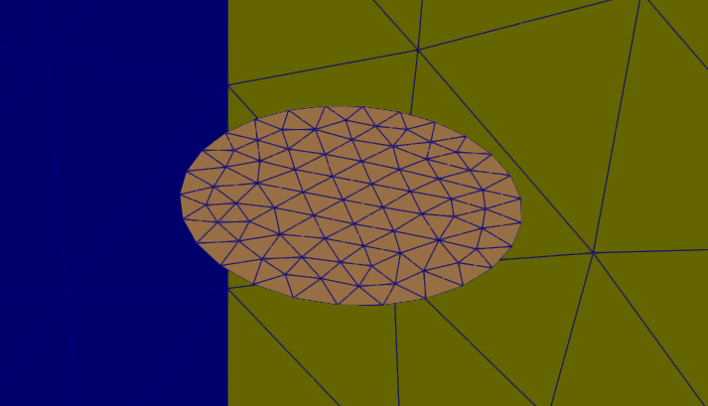
SNEDDON, COARSE MESH
ISOGEOMETRIC ANALYSIS?
Mesh Information:
elem_dimensions()={3}
spatial_dimension()=3
n_nodes()=13086
n_local_nodes()=3829
n_elem()=9138
n_local_elem()=2285
n_active_elem()=9138
Time: 10s
Maximum UZ displacement: 4.1952e-07
WMAX: 4.3450e-07
ERR: -3.45 %

Slide 9
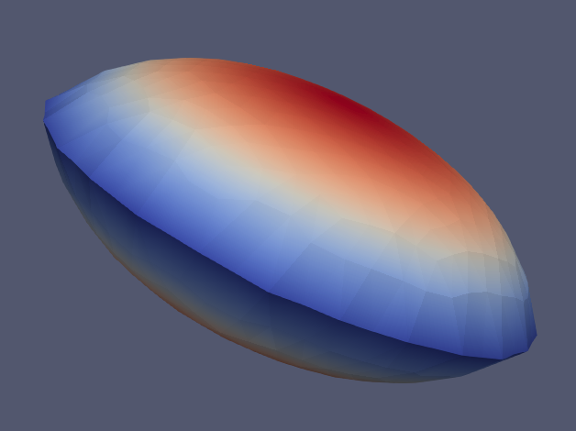
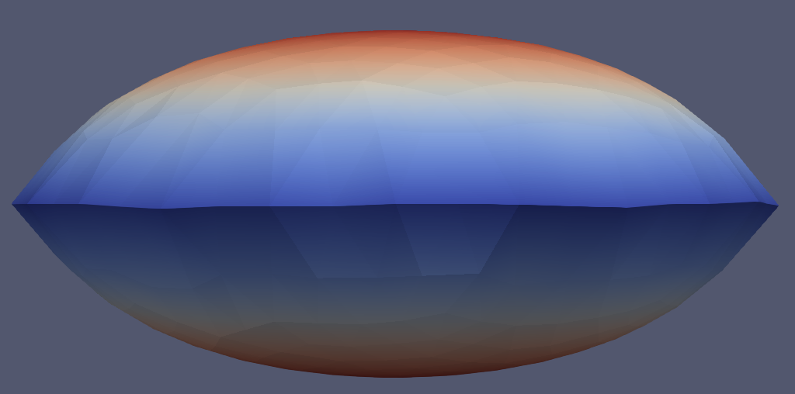
SNEDDON, COARSE MESH
Mesh Information:
elem_dimensions()={3}
spatial_dimension()=3
n_nodes()=13086
n_local_nodes()=3829
n_elem()=9138
n_local_elem()=2285
n_active_elem()=9138
Time: 10s
Maximum UZ displacement: 4.1952e-07
WMAX: 4.3450e-07
ERR: -3.45 %

Slide 10
DISCUSSION with LEE CHIN
may 12, 2024
Renato poli

Slide 11
Need to set a case to study
Given the case, we can choose among the design alternatives, based on the primary set of physical phenomena and numerics needed for the case.
He brought our attention to smeared crack models and the relevance of stress calculations

Slide 12
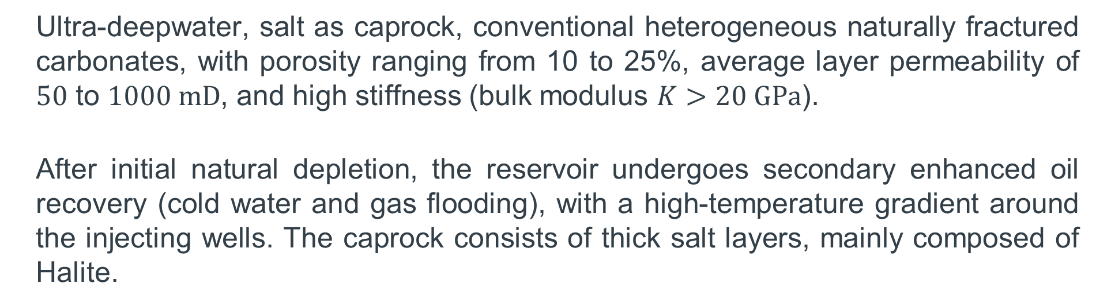
Offshore naturally fractured carbonate reservoir
Ultra-deepwater, salt as caprock, conventional heterogeneous naturally fractured carbonates, with porosity ranging from 10 to 25%, average layer permeability of $50$ to $1000 mD$, and high stiffness (bulk modulus $K>20 GPa$).
After initial natural depletion, the reservoir undergoes secondary enhanced oil recovery (cold water and gas flooding), with a high-temperature gradient around the injecting wells. The caprock consists of thick salt layers, mainly composed of Halite.

Slide 13
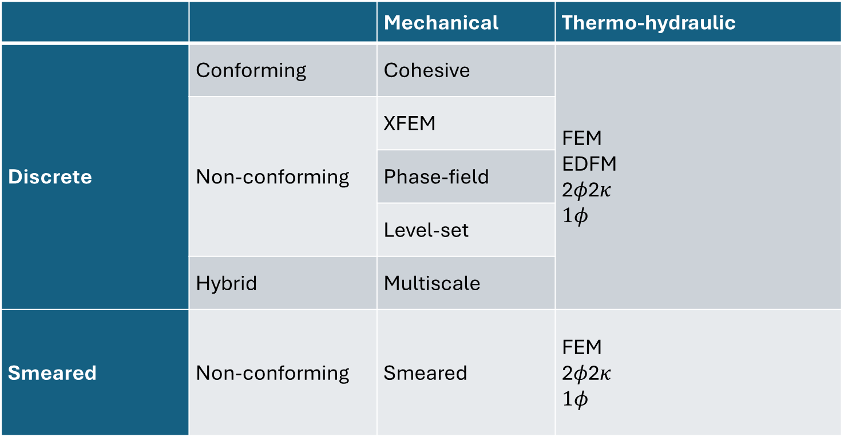
 |  | Mechanical | Thermo-hydraulic
Discrete | Conforming | Cohesive | FEM EDFM 2$φ$2$κ$ $1φ$
 | Non-conforming | XFEM
 |  | Phase-field
 |  | Level-set
 | Hybrid | Multiscale
Smeared | Non-conforming | Smeared | FEM 2$φ$2$κ$ $1φ$

Slide 14
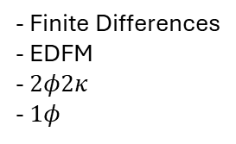
Mechanics
Stress
Global mechanics
(U_{i})
Hydraulic
(P, S_{w}, S_{o}, S_{g})
P
- Finite Element
- Smeared
- Finite Differences
- EDFM
- $2φ2κ$
- $1φ$
Bound. Cond.
Fracture
Effective params
T
P
Fracture propagation
(P, U_{i})
T
Thermal
(T)
- Finite Element
- Smeared
- Discrete
- Finite Differences

